Slide 1
CPSC331 - Spring 2019 Tutorial 19
Khobaib Zaamout

Slide 2
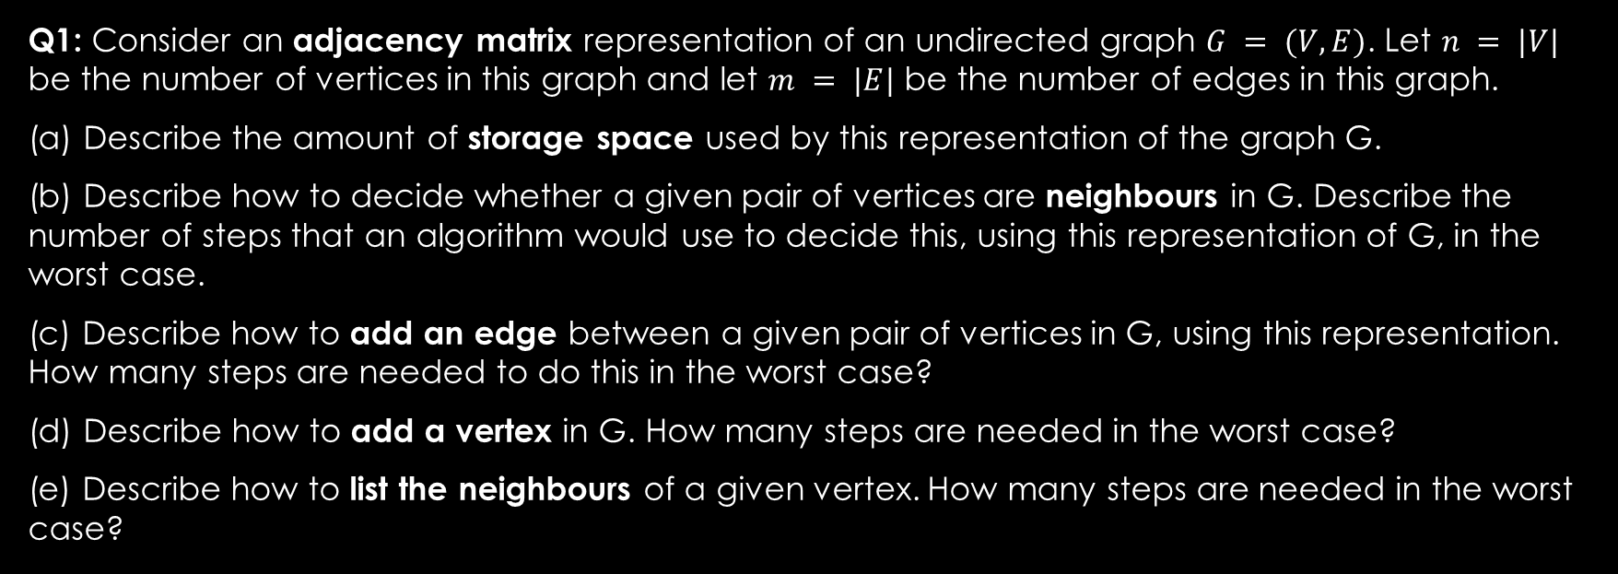
Q1: Consider an adjacency matrix
Q1: Consider an adjacency matrix representation of an undirected graph $G = (V,E)$. Let $n = |V|$ be the number of vertices in this graph and let $m = |E|$ be the number of edges in this graph.
(a) Describe the amount of storage space used by this representation of the graph G.
(b) Describe how to decide whether a given pair of vertices are neighbours in G. Describe the number of steps that an algorithm would use to decide this, using this representation of G, in the worst case.
(c) Describe how to add an edge between a given pair of vertices in G, using this representation. How many steps are needed to do this in the worst case?
(d) Describe how to add a vertex in G. How many steps are needed in the worst case?
(e) Describe how to list the neighbours of a given vertex. How many steps are needed in the worst case?

Slide 3
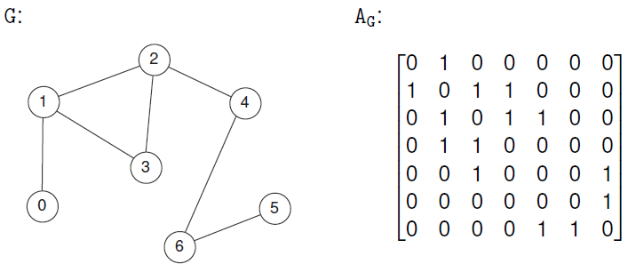
Q1: Consider an adjacency matrix

Slide 4
Q1: Consider an adjacency matrix
(a) Describe the amount of storage space used by this representation of the graph G.

Slide 5
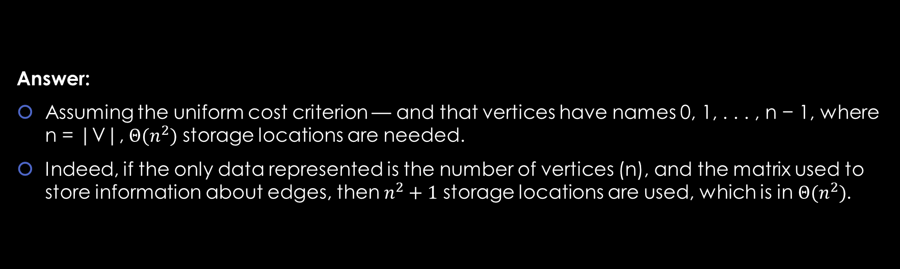
Q1: Consider an adjacency matrix
(a) Describe the amount of storage space used by this representation of the graph G.
Answer:
Assuming the uniform cost criterion — and that vertices have names 0, 1, . . . , n − 1, where n = |V|, $Θ(n^{2})$ storage locations are needed.
Indeed, if the only data represented is the number of vertices (n), and the matrix used to store information about edges, then $n^{2}+1$ storage locations are used, which is in $Θ(n^{2})$.

Slide 6
Q1: Consider an adjacency matrix
(b) Describe how to decide whether a given pair of vertices are neighbours in G. Describe the number of steps that an algorithm would use to decide this, using this representation of G, in the worst case.

Slide 7
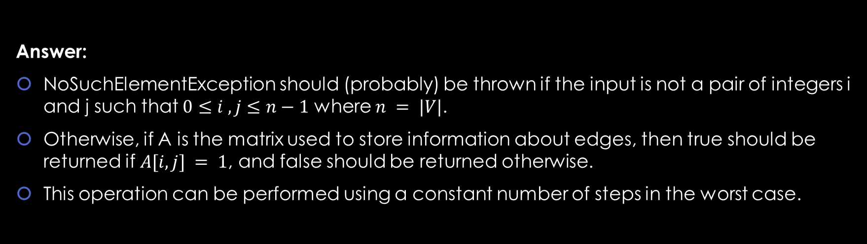
Q1: Consider an adjacency matrix
(b) Describe how to decide whether a given pair of vertices are neighbours in G. Describe the number of steps that an algorithm would use to decide this, using this representation of G, in the worst case.
Answer:
NoSuchElementException should (probably) be thrown if the input is not a pair of integers i and j such that $0≤i , j≤n−1$ where $n = |V|$.
Otherwise, if A is the matrix used to store information about edges, then true should be returned if $A[i, j] = 1$, and false should be returned otherwise.
This operation can be performed using a constant number of steps in the worst case.

Slide 8
Q1: Consider an adjacency matrix
(c) describe how to add an edge between a given pair of vertices in G, using this representation. How many steps are needed to do this in the worst case?

Slide 9
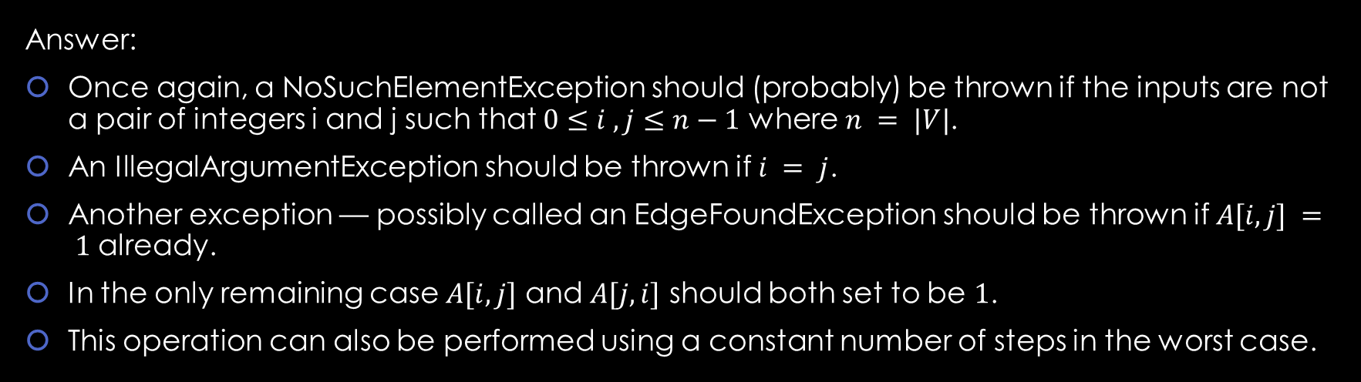
Q1: Consider an adjacency matrix
(c) describe how to add an edge between a given pair of vertices in G, using this representation. How many steps are needed to do this in the worst case?
Answer:
Once again, a NoSuchElementException should (probably) be thrown if the inputs are not a pair of integers i and j such that $0≤i , j≤n−1$ where $n = |V|$.
An IllegalArgumentException should be thrown if $i = j$.
Another exception — possibly called an EdgeFoundException should be thrown if $A[i, j] = 1$ already.
In the only remaining case $A[i, j]$ and $A[j, i]$ should both set to be $1$.
This operation can also be performed using a constant number of steps in the worst case.

Slide 10
Q1: Consider an adjacency matrix
(d) describe how to add a vertex in G. How many steps are needed in the worst case?

Slide 11
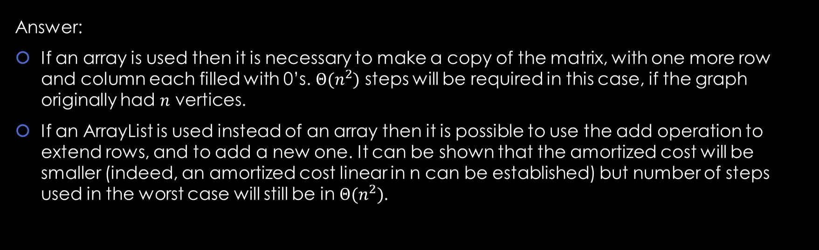
Q1: Consider an adjacency matrix
(d) describe how to add a vertex in G. How many steps are needed in the worst case?
Answer:
If an array is used then it is necessary to make a copy of the matrix, with one more row and column each filled with 0’s. $Θ(n^{2})$ steps will be required in this case, if the graph originally had $n$ vertices.
If an ArrayList is used instead of an array then it is possible to use the add operation to extend rows, and to add a new one. It can be shown that the amortized cost will be smaller (indeed, an amortized cost linear in n can be established) but number of steps used in the worst case will still be in $Θ(n^{2})$.

Slide 12
Q1: Consider an adjacency matrix
(e) describe how to list the neighbours of a given vertex. How many steps are needed in the worst case?

Slide 13
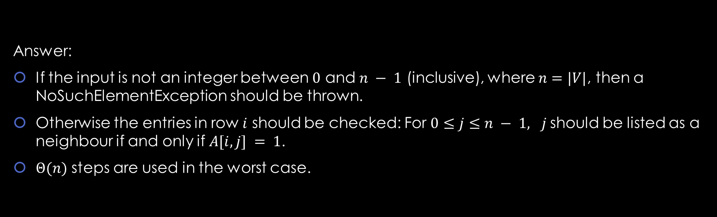
Q1: Consider an adjacency matrix
(e) describe how to list the neighbours of a given vertex. How many steps are needed in the worst case?
Answer:
If the input is not an integer between $0$ and $n − 1$ (inclusive), where $n=|V|$, then a NoSuchElementException should be thrown.
Otherwise the entries in row $i$ should be checked: For $0≤j≤n − 1, j$should be listed as a neighbour if and only if $A[i, j] = 1$.
$Θ(n)$ steps are used in the worst case.

Slide 14
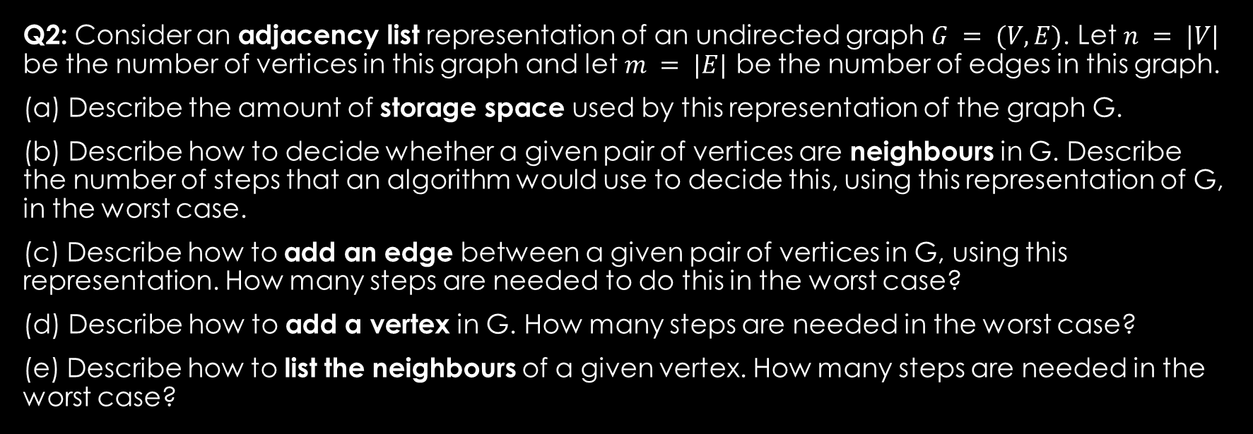
Q2: Consider an adjacency list
Q2: Consider an adjacency list representation of an undirected graph $G = (V,E)$. Let $n = |V|$ be the number of vertices in this graph and let $m = |E|$ be the number of edges in this graph.
(a) Describe the amount of storage space used by this representation of the graph G.
(b) Describe how to decide whether a given pair of vertices are neighbours in G. Describe the number of steps that an algorithm would use to decide this, using this representation of G, in the worst case.
(c) Describe how to add an edge between a given pair of vertices in G, using this representation. How many steps are needed to do this in the worst case?
(d) Describe how to add a vertex in G. How many steps are needed in the worst case?
(e) Describe how to list the neighbours of a given vertex. How many steps are needed in the worst case?

Slide 15
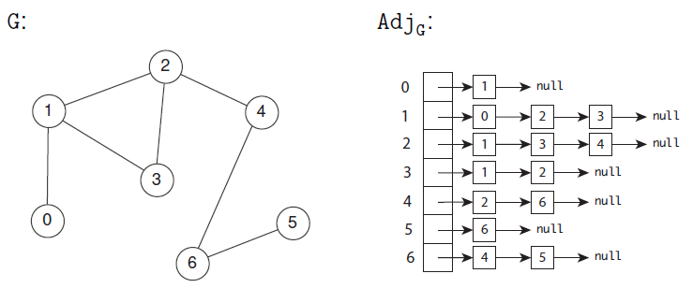
Q2: Consider an adjacency list

Slide 16
Q2: Consider an adjacency list
(a) Describe the amount of storage space used by this representation of the graph G.

Slide 17
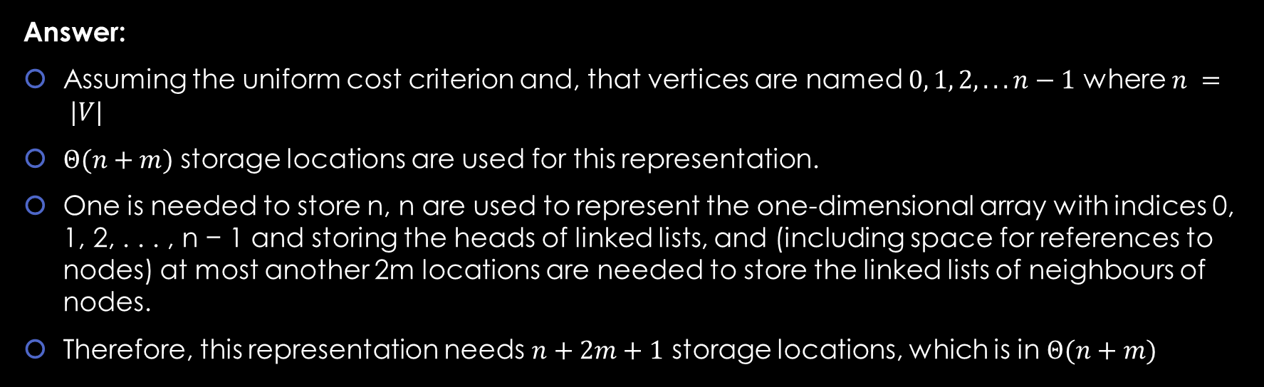
Q2: Consider an adjacency list
(a) Describe the amount of storage space used by this representation of the graph G.
Answer:
Assuming the uniform cost criterion and, that vertices are named $0, 1, 2, . . . n−1$ where $n = |V|$
$Θ(n+m)$ storage locations are used for this representation.
One is needed to store n, n are used to represent the one-dimensional array with indices 0, 1, 2, . . . , n − 1 and storing the heads of linked lists, and (including space for references to nodes) at most another 2m locations are needed to store the linked lists of neighbours of nodes.
Therefore, this representation needs $n+2m+1$ storage locations, which is in $Θ(n+m)$

Slide 18
Q2: Consider an adjacency list
(b) Describe how to decide whether a given pair of vertices are neighbours in G. Describe the number of steps that an algorithm would use to decide this, using this representation of G, in the worst case.

Slide 19
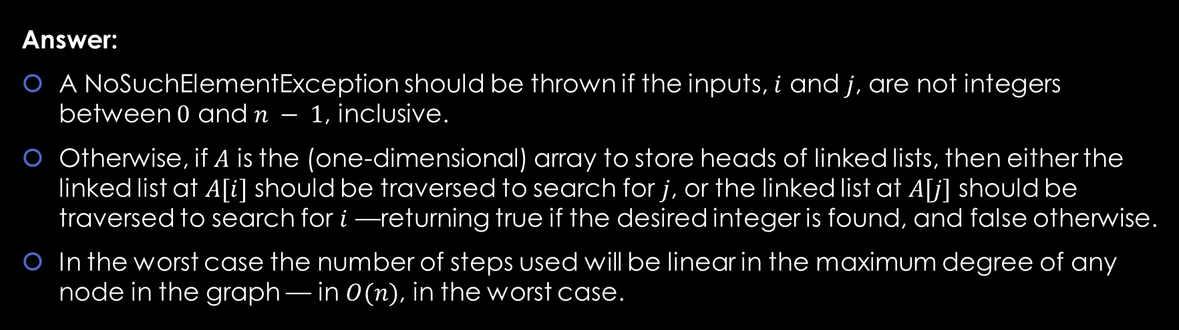
Q2: Consider an adjacency list
(b) Describe how to decide whether a given pair of vertices are neighbours in G. Describe the number of steps that an algorithm would use to decide this, using this representation of G, in the worst case.
Answer:
A NoSuchElementException should be thrown if the inputs, $i$ and $j$, are not integers between $0$ and $n − 1$, inclusive.
Otherwise, if $A$ is the (one-dimensional) array to store heads of linked lists, then either the linked list at $A[i]$ should be traversed to search for $j$, or the linked list at $A[j]$ should be traversed to search for $i$ —returning true if the desired integer is found, and false otherwise.
In the worst case the number of steps used will be linear in the maximum degree of any node in the graph — in $O(n)$, in the worst case.

Slide 20
Q2: Consider an adjacency list
(c) describe how to add an edge between a given pair of vertices in G, using this representation. How many steps are needed to do this in the worst case?

Slide 21
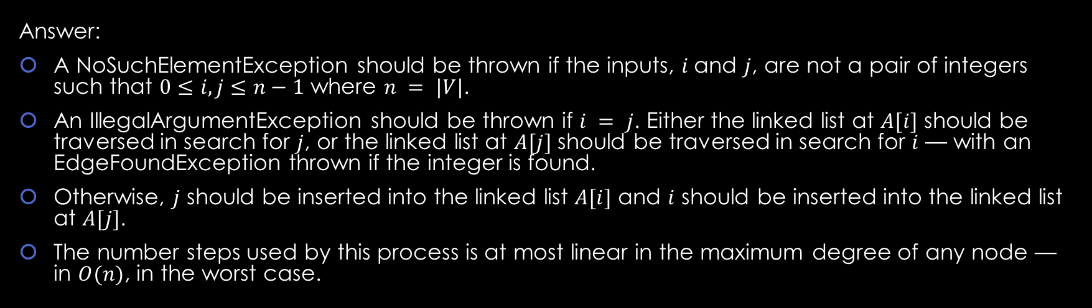
Q2: Consider an adjacency list
(c) describe how to add an edge between a given pair of vertices in G, using this representation. How many steps are needed to do this in the worst case?
Answer:
A NoSuchElementException should be thrown if the inputs, $i$and $j$, are not a pair of integers such that $0≤i, j≤n−1$ where $n = |V|$.
An IllegalArgumentException should be thrown if $i = j$. Either the linked list at $A[i]$ should be traversed in search for $j$, or the linked list at $A[j]$ should be traversed in search for $i$ — with an EdgeFoundException thrown if the integer is found.
Otherwise, $j$ should be inserted into the linked list $A[i]$ and $i$ should be inserted into the linked list at $A[j]$.
The number steps used by this process is at most linear in the maximum degree of any node — in $O(n)$, in the worst case.

Slide 22
Q2: Consider an adjacency list
(d) describe how to add a vertex in G. How many steps are needed in the worst case?

Slide 23
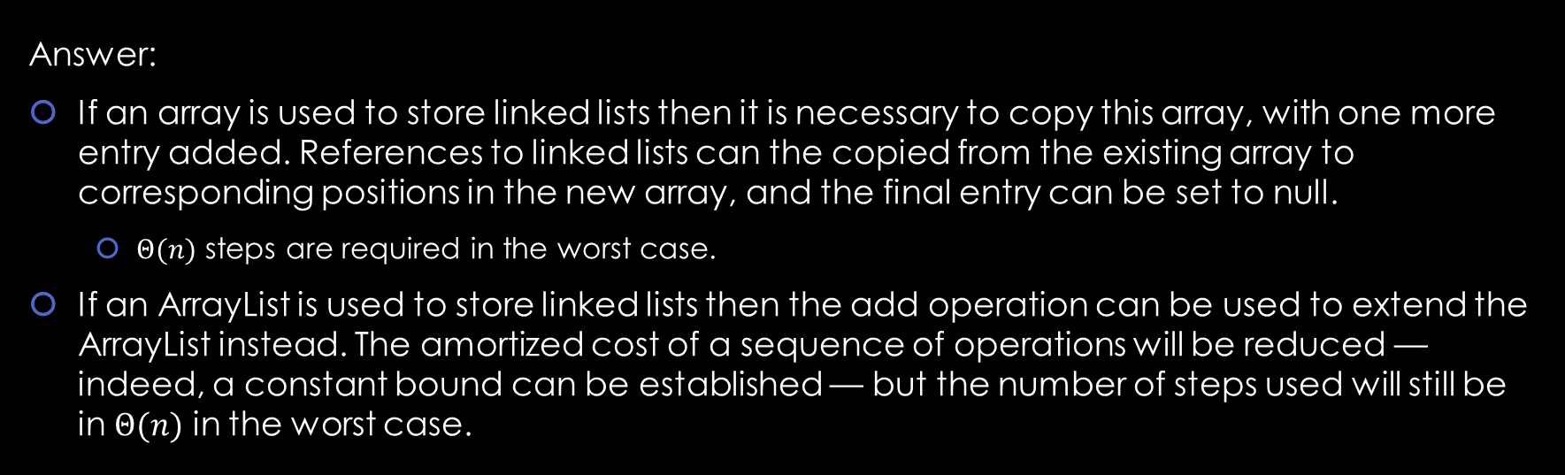
Q2: Consider an adjacency list
(d) describe how to add a vertex in G. How many steps are needed in the worst case?
Answer:
If an array is used to store linked lists then it is necessary to copy this array, with one more entry added. References to linked lists can the copied from the existing array to corresponding positions in the new array, and the final entry can be set to null.
$Θ(n)$ steps are required in the worst case.
If an ArrayList is used to store linked lists then the add operation can be used to extend the ArrayList instead. The amortized cost of a sequence of operations will be reduced — indeed, a constant bound can be established — but the number of steps used will still be in $Θ(n)$ in the worst case.

Slide 24
Q2: Consider an adjacency list
(e) describe how to list the neighbours of a given vertex. How many steps are needed in the worst case?

Slide 25
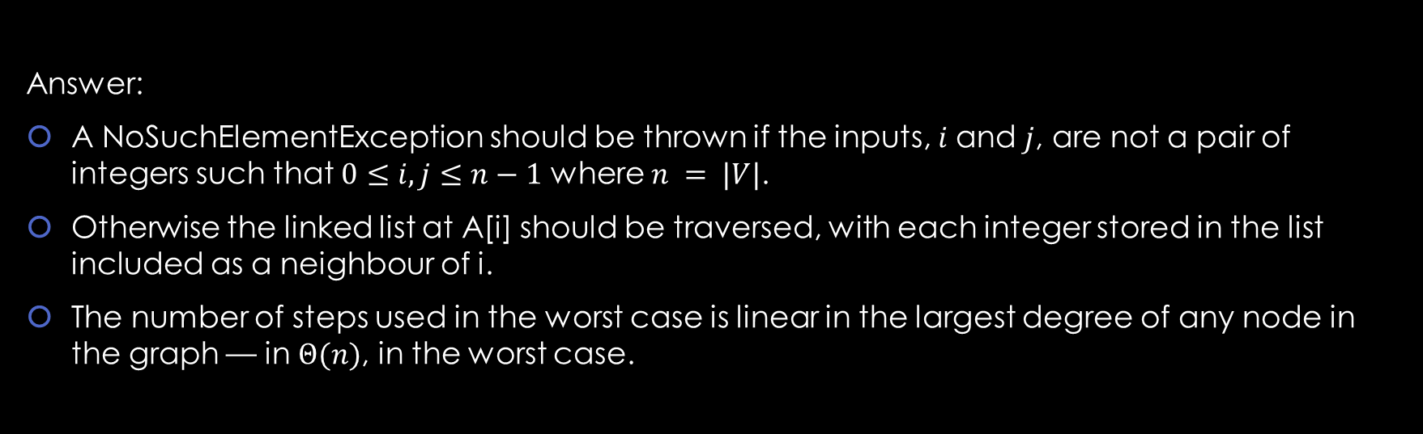
Q2: Consider an adjacency list
(e) describe how to list the neighbours of a given vertex. How many steps are needed in the worst case?
Answer:
A NoSuchElementException should be thrown if the inputs, $i$and $j$, are not a pair of integers such that $0≤i, j≤n−1$ where $n = |V|$.
Otherwise the linked list at A[i] should be traversed, with each integer stored in the list included as a neighbour of i.
The number of steps used in the worst case is linear in the largest degree of any node in the graph — in $Θ(n)$, in the worst case.

